Slide 1
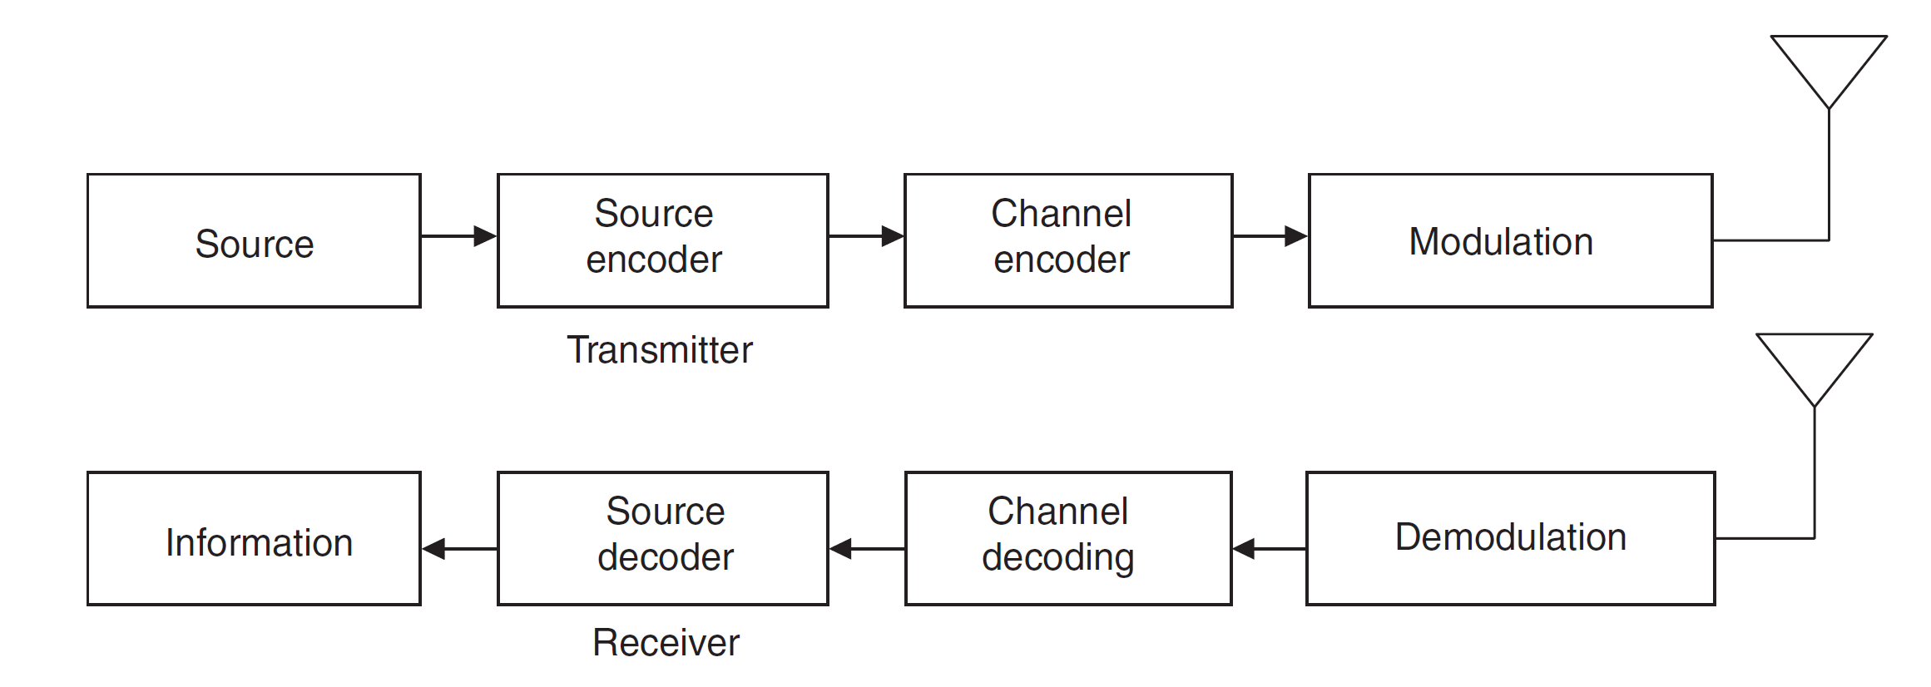
Wireless Communication System

Slide 2
Source Encoder
Source coding: Source coding deals with the time and amplitude discretization of the analog source signal.
There are various techniques of coding
We just consider Pulse Code Modulation (PCM), a basic form of waveform coding

Slide 3
Pulse-code modulation (PCM)
Pulse-code modulation (PCM) is a method used to digitally represent sampled analog signals.
It is the standard form of digital audio in computers, Compact Discs, digital telephony and other digital audio applications.
In a PCM stream, the amplitude of the analog signal is sampled regularly at uniform intervals, and each sample is quantized to the nearest value within a range of digital steps.

Slide 4
Sampling
  the amplitude of the analog signal is sampled regularly at uniform intervals
  Pulse Amplitude Modulation (PAM)
  Sample rate is the number of samples per second, for telephone the sample rate is 8Khz, VoIP 16KHz, Mp3 is 44KHz
Quantized
  Bit depth used to quantize analog signal, we use 8bit,16bit, 24bit.
Encoding

Slide 5
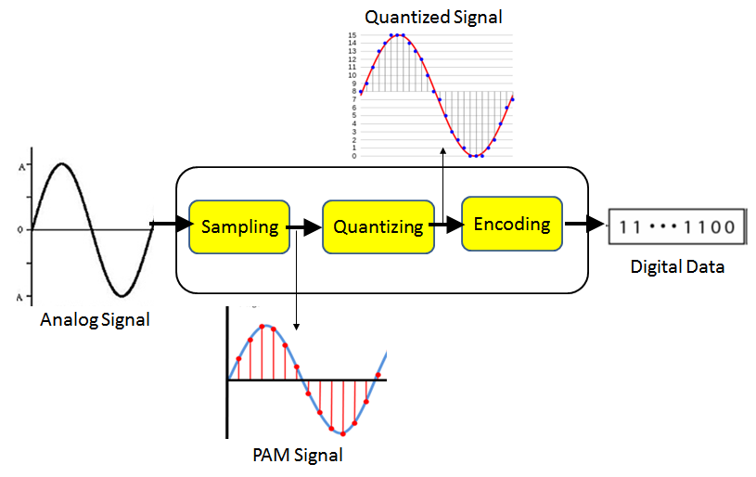

Slide 6
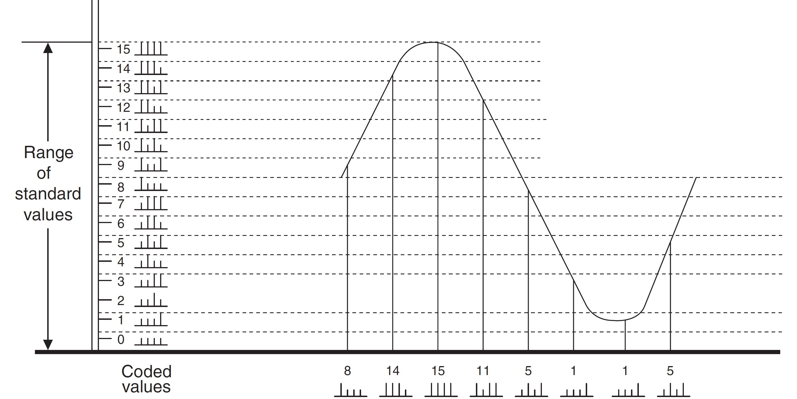
Sampling 8 Hz
Quantize 4 bit
Encoding result(32 bits/s) (1000 1110 1111 1011 0101 0001 0001 0101)

Slide 7
Wireless Communication System

Slide 8
Channel Coding
Channel coding is a technique used in digital communications to ensure a transmission is received with minimal or no errors.
Coding adds additional bits to the original payload to provide a means of protecting the original information.
The purpose of the channel encoder is to provide the receiver with the ability to detect transmission errors.

Slide 9
Cyclic redundancy check
Cyclic redundancy check (CRC) is probably the most reliable scheme for error detection.
Let k = Block of binary data, an n = length of CRC sequence, which is appended to the k-bit data block.
The n-bit CRC determined in such a way that the resulting k + n bit sequence is exactly divisible by some predetermined bit string (generator polynomial) which is n + 1 bit long.

Slide 10
The steps in CRC generation are as follows:
For the binary data of k and generator polynomial G with n bits, a string of n − 1 zero bits is appended to k.
Then k (appended with zero bits) is divided by the generator G.
The quotient of this division is discarded, but the remainder is called CRC.
The CRC value is appended to k (without appended zero bits) and transmitted.

Slide 11
Example
Consider the data to be transmitted k is 101110 using CRC-error checking method. Suppose the generator polynomial G is chosen as 1001(X³+1). Find the final value that the transmitter sends and show the error detection process at the receiver.

Slide 12
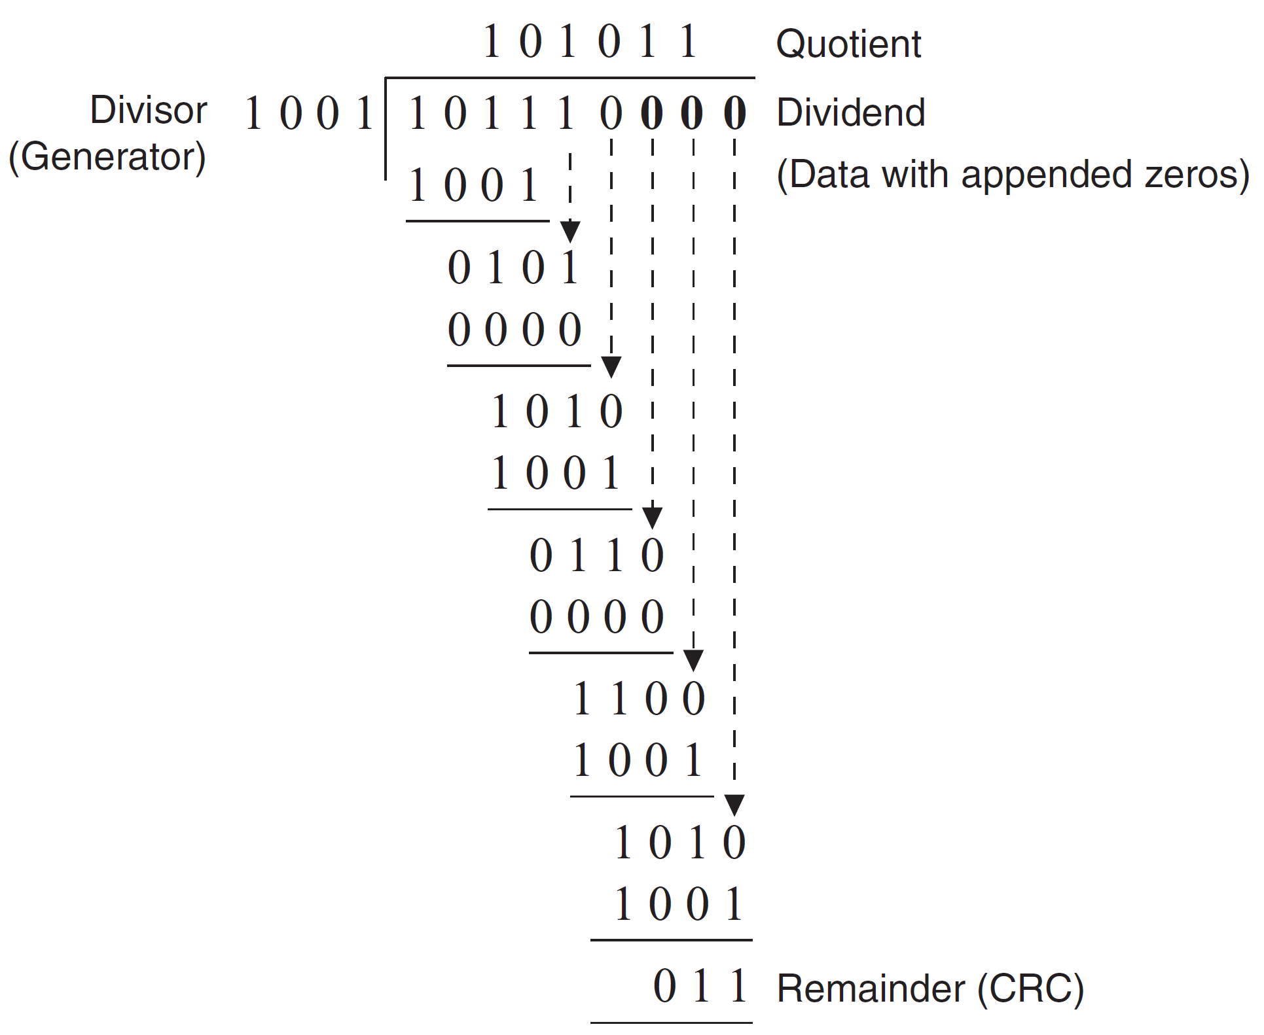
CRC
AT Transmitter

Slide 13
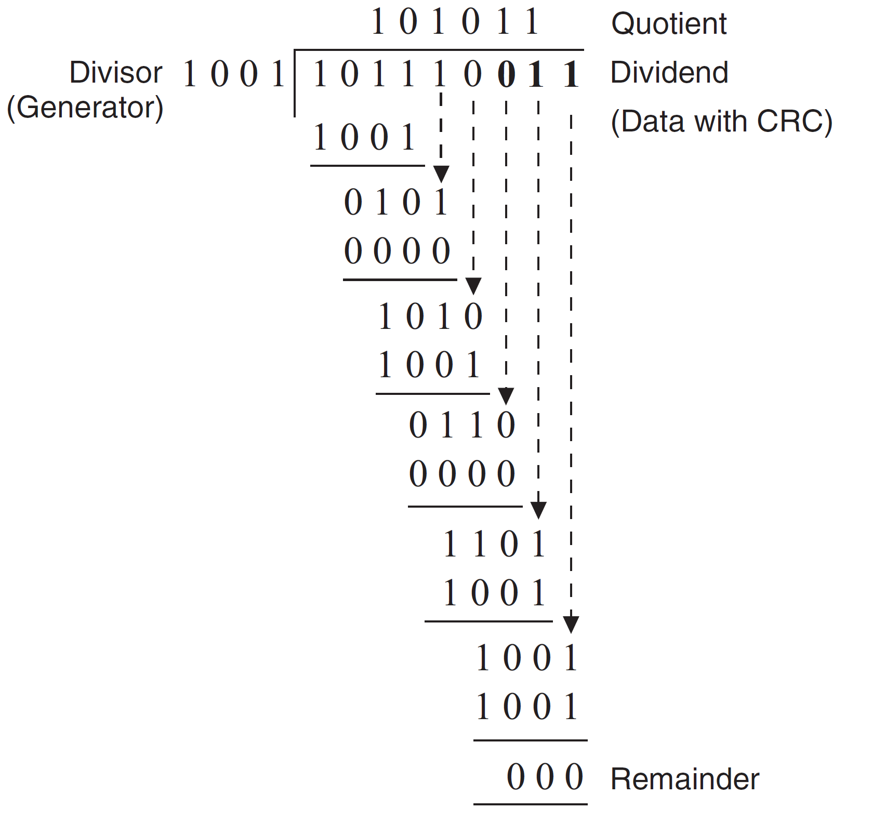
CRC
AT Receiver

Slide 14
Wireless Communication System

Slide 15
Radio Frequency Modulation
In order for an electromagnetic wave to transmit information it must be modified
  Modification is called modulation or keying
An electromagnetic wave that has been modified in order to carry information is a carrier
  Also called carrier wave or carrier signal
Modulations can be performed on either analog or digital transmissions
Modulation is the process of changing some property such as amplitude or frequency of the carrier wave with data signal

Slide 16
Analog Modulation
Analog signal: continuous signal with no breaks
Amplitude modulation (AM): Changes amplitude so that highest peaks of carrier wave represent 1 bit while lower waves represent 0 bit
Frequency modulation (FM): Changes number of waves representing one cycle
  Number of waves to represent 1 bit more than number of waves to represent 0 bit
Phase modulation (PM): Changes starting point of cycle
  When bits change from 1 to 0 bit or vice versa

Slide 17
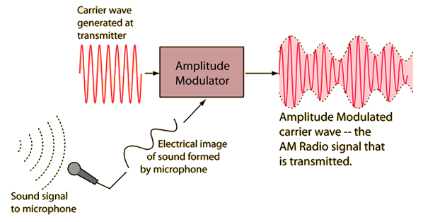
Amplitude modulation (AM)

Slide 18
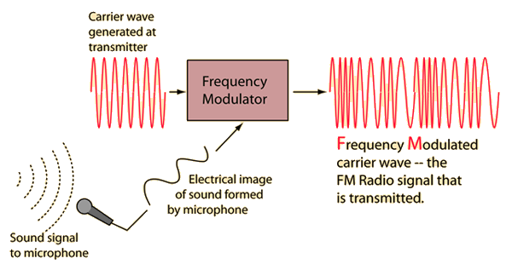
Frequency modulation (FM)

Slide 19
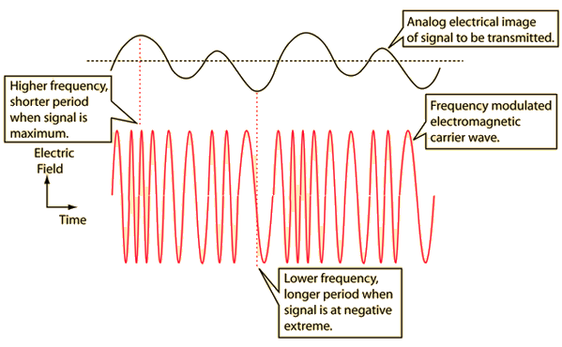
Frequency modulation (FM)

Slide 20
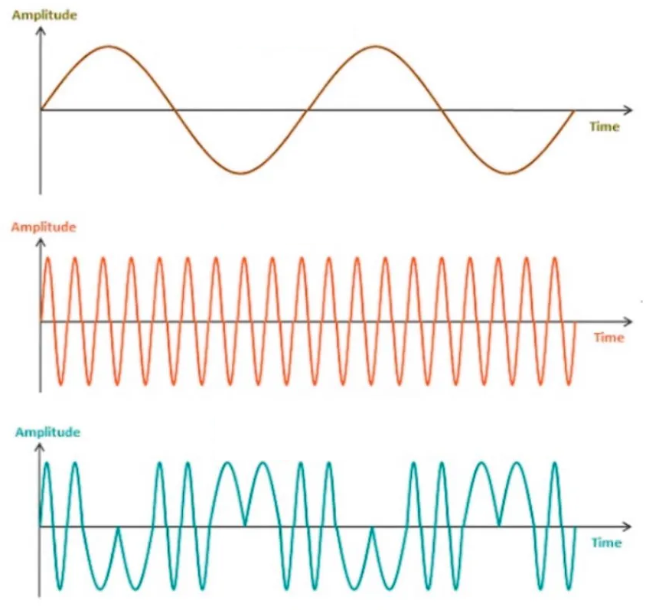
Message Signal
Carrier Signal
Phase Modulated Signal
Phase modulation (PM)

Slide 21
Digital Modulation
Digital signal: consists of data that is discrete or separate (unlike analog which is continuous)
Advantages over analog modulation:
  Better use of bandwidth
  Requires less power
  Better handling of interference from other signals
  Error-correcting techniques more compatible with other digital systems
Uses same three basic types of modulation as analog

Slide 22
Digital Modulation
Amplitude shift keying (ASK): similar to amplitude modulation
  Instead of both a 1 bit and a 0 bit having a carrier signal, the ASK 1 bit has a carrier signal and a 0 bit has no signal
Frequency shift keying (FSK): changes the frequency of the carrier signal
Phase shift keying (PSK): similar to phase modulation
  PSK signal starts and stops because it is a binary signal

Slide 23
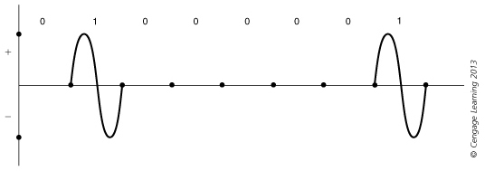
Amplitude shift keying (ASK)

Slide 24
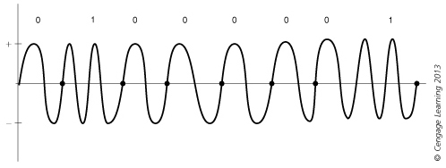
Frequency shift keying (FSK)

Slide 25
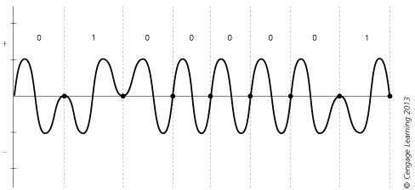
Phase shift keying (PSK)

Slide 26
Spread Spectrum
Spread spectrum was developed in World War II to prevent enemies from intercepting and jamming transmissions.
In spread spectrum, a data signal is sent over a range of frequencies in an assigned frequency spectrum.
A pseudo-random spreading code is used to multiplex the base signal. Multiplexing with a spreading code increases the bandwidth required for the signal, spreading it out over the available spectrum.

Slide 27
There are two types of spread spectrum techniques
Frequency Hopping Spread Spectrum (FHHS)
  The large bandwidth is effectively split into frequency channels.
  Sends Data on one frequency at a time
  Hopping pattern is only known to sender and receiver.
Directs Sequence Spread Spectrum (DSSS)
  Combine data signals directly with a higher bit rate
  Each bit in the original signals is represented by multiple bits in the transmitted signal, using a pseudo random noise code (PN-code).
  The we use XOR technique

Slide 28
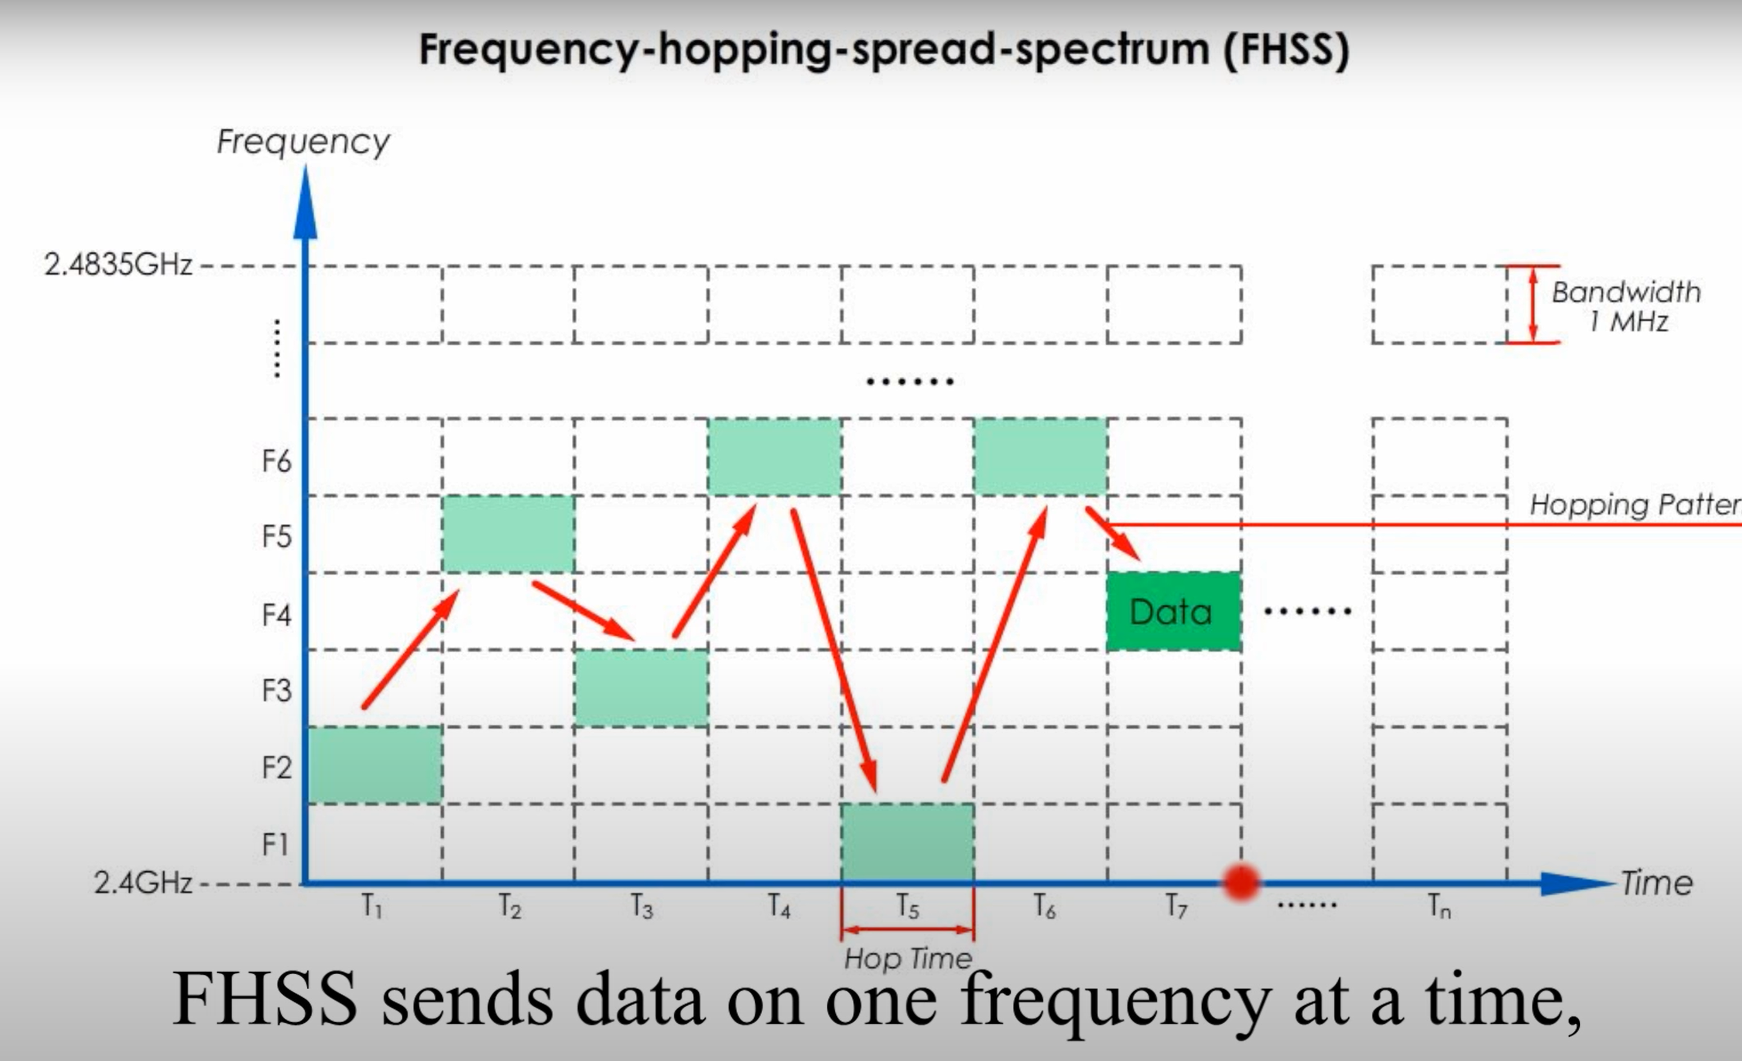
FHSS

Slide 29
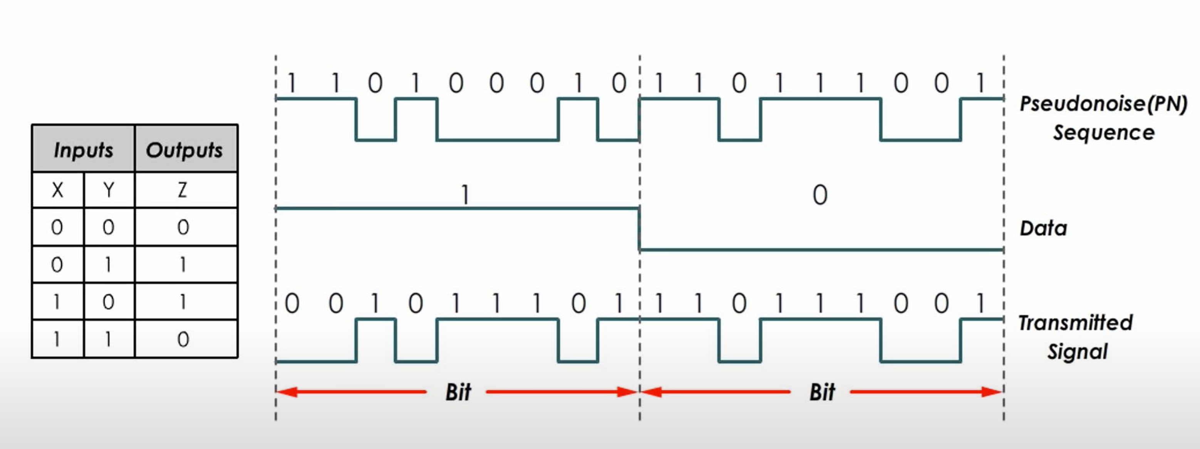
DSSS

Slide 30
Multiplexing
The multiplexing refers to a method which aims at combining multiple signals into one signal such that each user would be able to extract its desired data upon receiving the multiplexed signal
It enables many users to take advantage of the same medium for data transmission

Slide 31
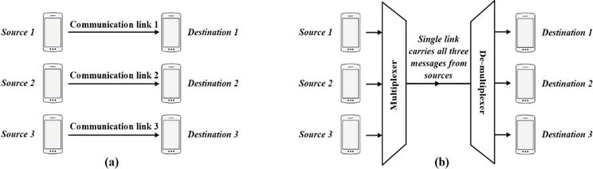
A communication system comprising three sources and destinations: (a) without multiplexing and (b) with multiplexing.

Slide 32
Multiplexing (Cont)
Multiplexing brings the following advantages to wireless communication systems.
Reducing the communication cost.
Enhancing the connectivity.
Saving valuable communication resources.
Improving network capacity.
Eliminating the need of exclusive links between sources and destinations.

Slide 33
Multiplexing (Cont)
We have four basic categories:
1. FDM (Frequency Division Multiplexing)
2. TDM (Time Division Multiplexing)
3. CDM (Code Division Multiplexing)

Slide 34
Time division multiplexing (TDM)
Time division multiplexing (TDM) is the first multiplexing scheme has been introduced to be employed in wired and wireless networks
TDM separates signals from different sources over non-overlapping time slots to share the same spectral medium
The simplest TDM can be modelled as a switch that periodically moves between multiple sources

Slide 35
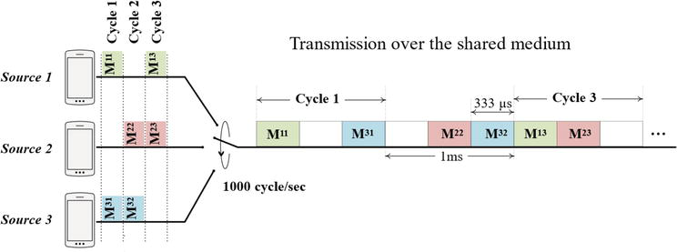
Time division multiplexing (TDM)
example of synchronous TDM for three independent sources in three cycles. The switch rotates between states (sources) with the rate of 1000 cycle per second. Hence, the cycle time is 1ms , and each time slot equals to 333.3μs .

Slide 36
Time division multiple access (TDMA)
For TDMA, after the user finishes using the time slot, the time slot is freed and can be used by another user. usually time slots are dynamically assigned and the user may get a different time slot each time he accesses the network

Slide 37
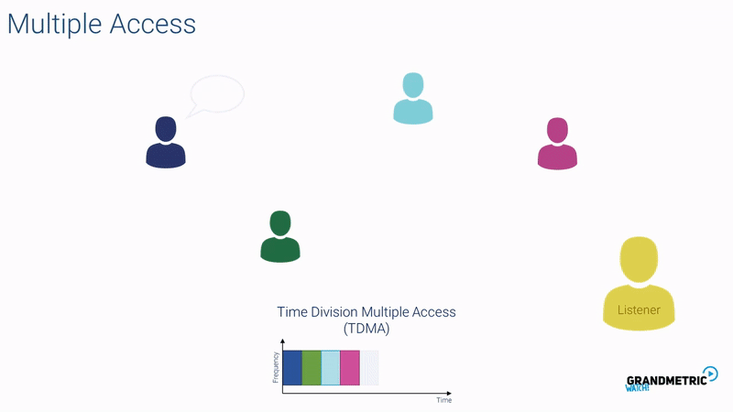

Slide 38
Frequency division multiplexing
FDM
FDM is multiplexing technique which divides the available bandwidth into multiple sub-bands each of which is able to carry a signal.
Therefore, FDM enables concurrent transmissions over a shared communication medium.
FDM enables the system to send a huge amount of data through several segments transmitted over independent frequency sub-bands.
FDM insert a guard which it is a narrow frequency range, between adjacent sub channels so different signals are travel separately without interfering with each others

Slide 39
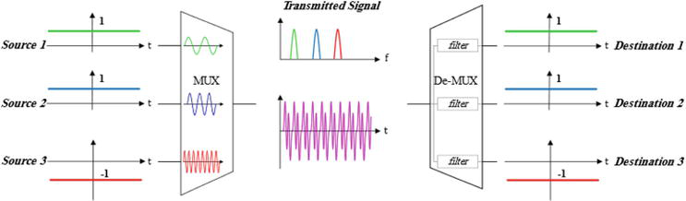
Guard

Slide 40
Frequency division multiple access FDMA
FDMA can use multiple frequencies in same time while FDM can only use one carrier frequency at a time.
FDMA more efficient in terms of spectrum usage and allows for faster data rates. In addition, FDMA is better suited for mobile applications since it can handle more users per cell site.

Slide 41
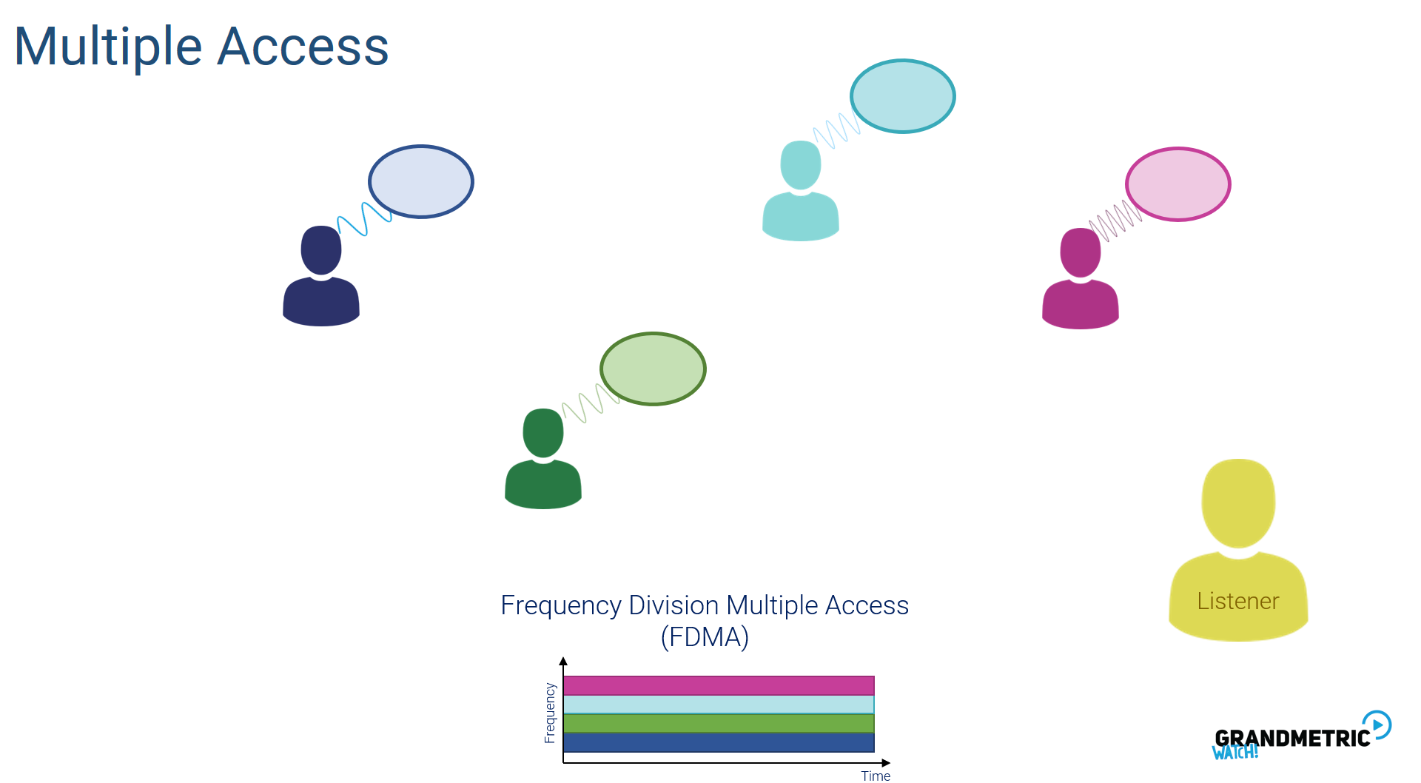

Slide 42
Orthogonal Frequency division multiplexing OFDM
OFDM is a vey popular multiplexing method used for many of the latest wireless and telecommunication standards, such as WiFi 802.11ac,4G,5G WiMAX, Satellite and more.
In OFDM the guard space is removed and the signals are overlapped, for that OFDM allow more data transitions than FDM.
OFDM prevent interference because signal are orthogonal to each other, which means that signals are multiplexing in a way that the peak of one signal occurs at null of other neighbor signals.

Slide 43
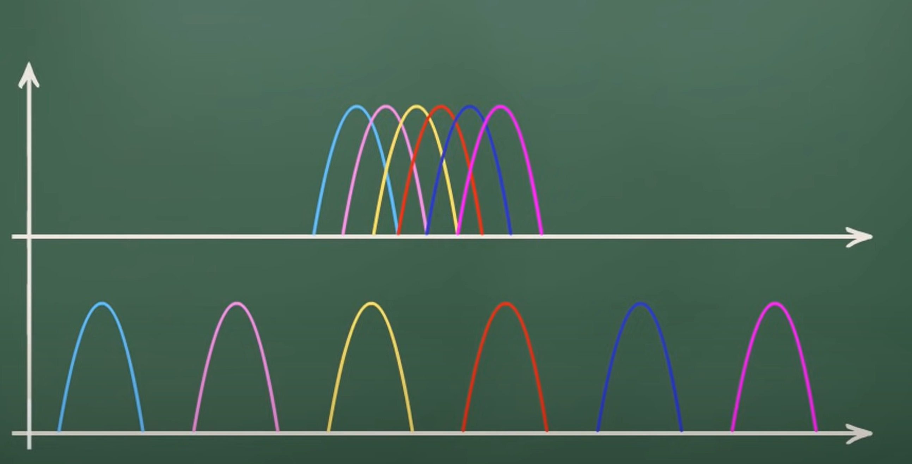
OFDM
Guard
Guard
Guard
Guard
Guard

Slide 44
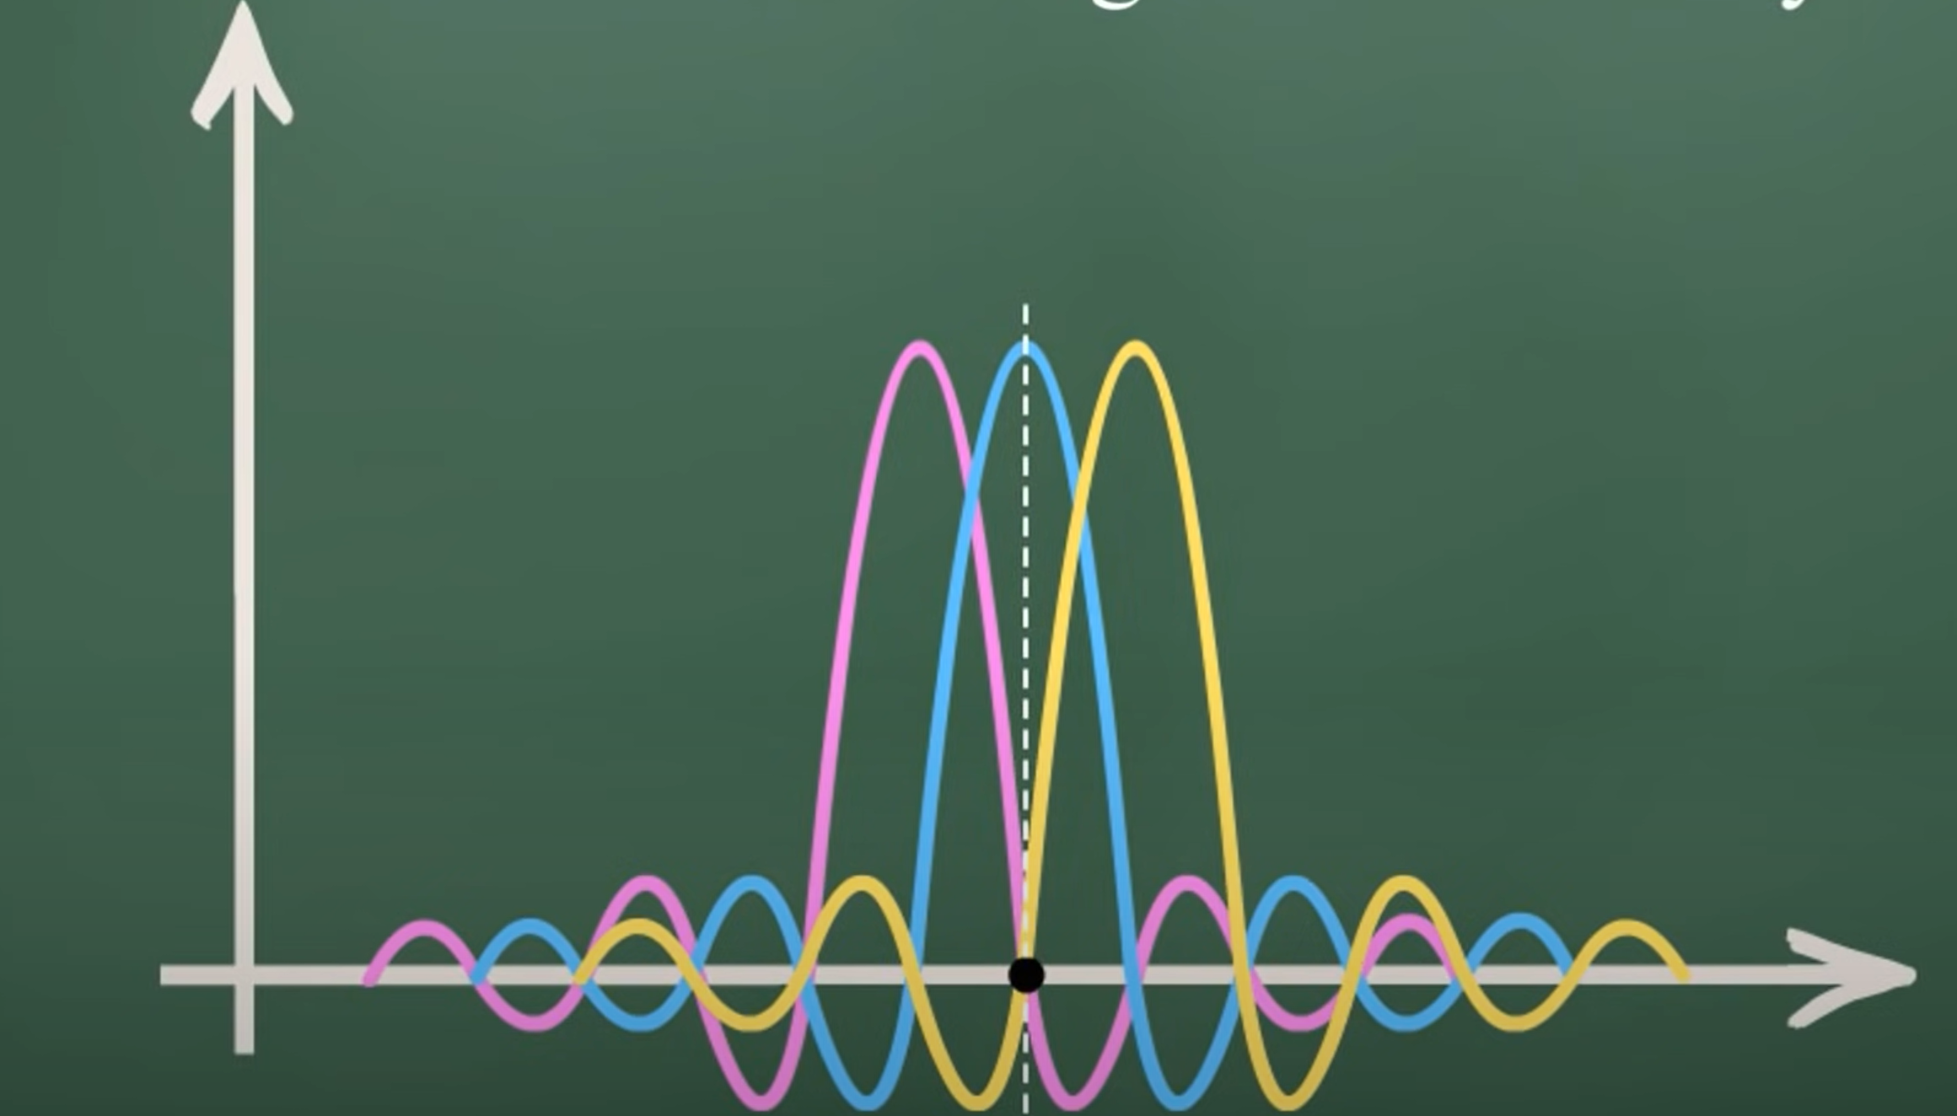

Slide 45
Code division multiplexing
CDM
(CDM) is a multiplexing technique that uses spread spectrum communication. In spread spectrum communications, a narrowband signal is spread over a larger band of frequency or across multiple channels via division.
Instead of dividing the allowed frequency range into a few hundred narrow channels or time period, CDM allows each station to transmit over the entire frequency spectrum all the time.

Slide 46
Code Division Multiplexing (continued)
To send a binary 1, a mobile device transmits the unique code
To send a binary 0, a mobile device transmits the inverse of the code
To send nothing, a mobile device transmits zeros
Data Communications and Computer Networks: A Business User's Approach, Eighth Edition
© 2016. Cengage Learning. All Rights Reserved.

Slide 47
Code Division Multiplexing (continued)
For simplicity, assume 8-bit code
Example
  Three different mobile devices use the following codes:
    Mobile A: 11110000
    Mobile B: 10101010
    Mobile C: 00110011
  Assume Mobile A sends a 1, B sends a 0, and C sends a 1
  Signal code: 1-chip = +N volt; 0-chip = -N volt
Data Communications and Computer Networks: A Business User's Approach, Eighth Edition
© 2016. Cengage Learning. All Rights Reserved.

Slide 48
Code Division Multiplexing (continued)
Example (continued)
  Three signals transmitted:
    Mobile A sends a 1, or 11110000, or ++++----
    Mobile B sends a 0, or 01010101, or -+-+-+-+
    Mobile C sends a 1, or 00110011, or --++--++
  Summed signal received by base station: -1, +1, +1, +3, -3, -1, -1, +1
Data Communications and Computer Networks: A Business User's Approach, Eighth Edition
© 2016. Cengage Learning. All Rights Reserved.

Slide 49
Code Division Multiplexing (continued)
Example (continued)
  Base station decode for Mobile A:
    Signal received: -1, +1, +1, +3, -3, -1, -1, +1
    Mobile A’s code: +1, +1, +1, +1, -1, -1, -1, -1
    Product result: -1, +1, +1, +3, +3, +1, +1, -1
  Sum of Products: +8
  Decode rule: For result near +8, data is binary 1
Data Communications and Computer Networks: A Business User's Approach, Eighth Edition
© 2016. Cengage Learning. All Rights Reserved.

Slide 50
Code Division Multiplexing (continued)
Example (continued)
  Base station decode for Mobile B:
    Signal received: -1, +1, +1, +3, -3, -1, -1, +1
    Mobile B’s code: +1, -1, +1, -1, +1, -1, +1, -1
    Product result: -1, -1, +1, -3, -3, +1, -1, -1
  Sum of Products: -8
  Decode rule: For result near -8, data is binary 0
Data Communications and Computer Networks: A Business User's Approach, Eighth Edition
© 2016. Cengage Learning. All Rights Reserved.

